Slide 1


Humbowo pamusoro penzira dzekudzivirira HIV

Slide 2

Nzira dzekudzivirira HIV
Pane zvinhu zvizhinji zvamunokwanisa kuita kuderedza njodzi yenyu kana youmwe wenyu yekubatira HIV.
Vana chipangamazano vanoda kukubatsirai kunzwisisa mikana yese inotevera yokudzivirira HIV kuitira kuti mugone kusarudza nzira inoshanda zvakanakisa kwamuri.

Slide 3
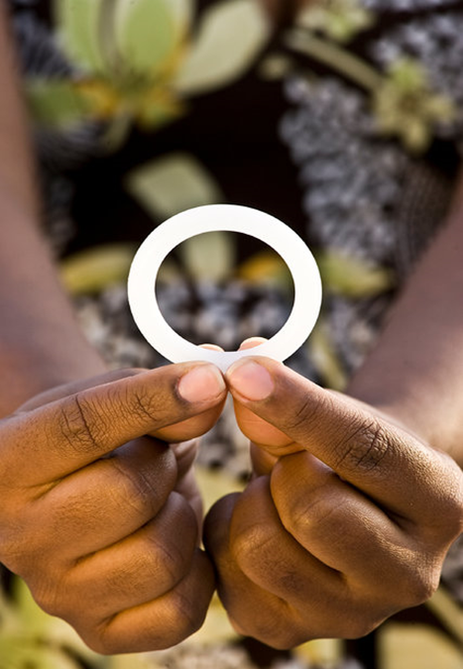
Tsvakurudzo dzakataridza kuti dapivirine ring yemukati menhengo yesikarudzi yomudzimai inokwanisa kuderedza mukana wemudzimai wokubatira hutachiwana hweHIV. Kudzivirirwa kubva mukubatira hutachiwana hweHIV kwakanyanyisa kana ring ichishandiswa nguva dzese.
Shandisa dapivirine ring yemunzira yesikarudzi yomudzimai nguva dzese

Slide 4
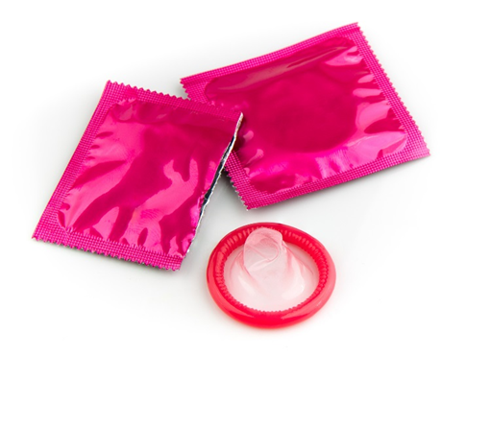
Shandisai makondomu nguva dzese
Shandisai kondomu zvakanaka nguva dzose dzamunosangana pabonde nemunzira yesikarudzi yemudzimai, nekumashure kunobuda netsvina kana nebonde remukanwa.
Notes:
Tarisai kumashure kwegwaro iri kuti muwane humbowo hwakapamhidzirwa pamusoro pemakondomu.

Slide 5
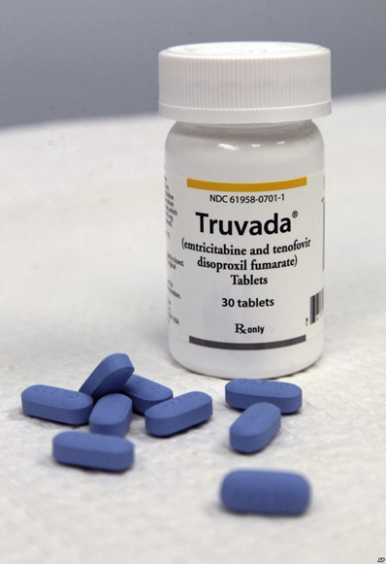
Shandisai mushonga wekunwa wekudzivirira kubatira HIV ( PrEP) (seTruvada)
Mushonga wekunwa wekudzivirira kubatira HIV (PrEP) ndoumwe mukana wekuzvidzivirira kubatira HIV wevanhu vasina hutachiwana hwe HIV asi vari panjodzi huru yekubatira hutachiwana hwe HIV.
Mushonga wekunwa wekudzivirira kubatira HIV (PrEP) unosanganisira kunwa mhando chaiyo yemushonga we HIV mazuva ese.
Mushonga wekunwa wekudzivirira kubatira HIV (PrEP) ungangowanikwa kana kusawanikwa munharaunda yenyu.
Notes:
Kana zvichiita somukana wamungade kushandisa, taurai nevashandi vepakiriniki maererano nekunzwa kana zvichiwanikwa munharaunda.

Slide 6
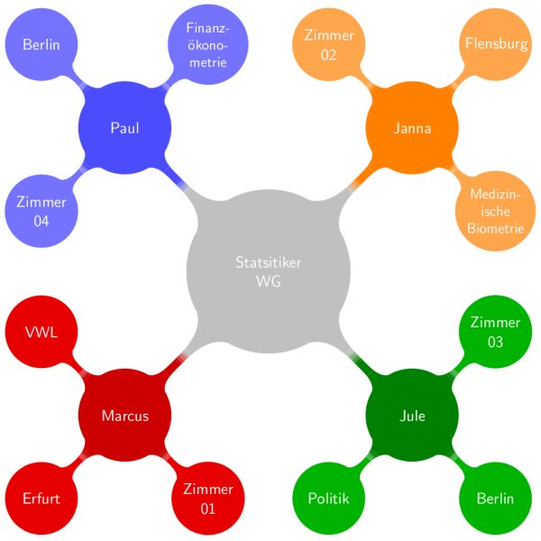
Deredzai huwandu hwevamunosangana navo pabonde
Notes:
Kuwanda kweshamwari dzenyu dzepabonde dzamuinadzo , kunowedzera mukana wenyu wekuva neshamwari yabonde ine HIV. Kana umwe wenyu aine vamwe vake vakawanda, mukurudzirei kuderedza huwandu uhwu zvakare. Zvinoderedza njodzi yokubatira HIV kwamuri mose.

Slide 7
Itai hunhu wepabonde hunenjodzi yakaderera
Kuita bonde nemumukanwa kune njodzi yakashomeka panekuita bonde nemunzira yesikarudzi yemudzimai kana nekumashure kunobuda netsvina.
Vanhu vazhinji vanofunga kuti bonde nekumashure kunobuda netsvina mukana unenjodzi yakaderera, asi chokwadi ndechekuti ndiyo nzira yepabonde ine njodzi yakanyanyisa kukwira yekutapurirana HIV.

Slide 8

Kana muine chirwere chepabonde (STI) rapiwai
Kuva nechirwere chepabode kunogona kuwedzera njodzi yenyu yekubatira HIV kana kuitapurira kune vamwe. Simbirirai kuti vamwe venyu vaongororwe uye varapiwewo.

Slide 9

Kurudzirai umwe wenyu kuti aongororwe HIV
Taurai neumwe wenyu pamusoro pekuongororwa HIV uye ongororwai musati masangana pabonde.
Kuziva kana umwe wenyu aine hutachiwana hweHIV kunogona kukubatsirai kusarudza nzira dzekudzivirira dzingangove dzinokushandirai imi zvakanyanya.

Slide 10
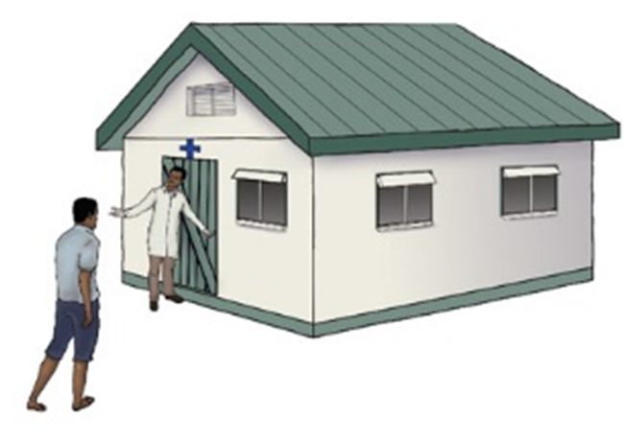
Kurudzirai umwe wenyu kuti achecheudzwe
Varume vakachecheudzwa vane mukana ungangove pakati nepakati wekubatira HIV pane varume vasina kuchecheudzwa.
Kuchecheudzwa kwevarume hakudzivirire madzimai kubva mukubatira HIV.

Slide 11

Kana umwe wenyu aine hutachiwana hwe HIV, mukurudzirei kuti anwe mishonga ye HIV sezvaakarairwa
Notes:
Kurapiwa nemishonga ye HIV ( inonzi antiretroviral therapy kana ART muchidimbu) kunobatsira vanhu vane HIV kurarama kwenguva refu, nokurarama zvinehutano hurinani. Mishonga ye HIV (ART) haigoni kupedza hutachiwana hweHIV, asi inogona kuderedza huwandu hwe HIV mumuviri. Kuva neHIV shoma mumuviri kunoderedza njodzi yekuti umwe wenyu atapurire HIV panguva yebonde.

Slide 12
Kunyange nzira dzose dzikasagoneka kumadzimai ose, kuwanda kwezvinhu zvamunogona kuita, kunowedzera kuderedza mukana wenyu wokubatira HIV.
Kana umwe wenyu aine hutachiwana hwe HIV, mukurudzirei kuti anwe mishonga ye HIV sezvaakarairwa

Slide 13

Humbowo hwakapamhidzirwa pamusoro pemakondomu
Makondomu anodzivirira kubatira hutachiwana hweHIV kubva pakusangana pabonde nemunzira yesikarudzi yemudzimai uye nekumashure kunobuda netsvina.
Ring yedapivirine inoderedza njodzi yokubatira HIV nekusanga pabonde nemunzira yesikarudzi yemudzimai.
Ring haina kugadzirwa kudzivirira kutapuriranwa kweHIV pakusangana nekumashure kunobuda netsvina uye haifaniri zvachose kushandiswa kumashure kunobuda netsvina.

Slide 14
Humbowo hwakapamhidzirwa pamusoro pemakondomu:
Makondomu anodzivirira kubatira pamuviri uye zvimwe zvirwere zvepabonde.
Notes:
Kupamhidzira kudzivirira kubatira HIV, makondomu anezvimwe zvinobatsira zvehutano. Vamwe varume nevakadzi vanosarudza makondomu senzira yokuronga mhuri kudzivirira pamuviri pasina kurongwa.

Slide 15
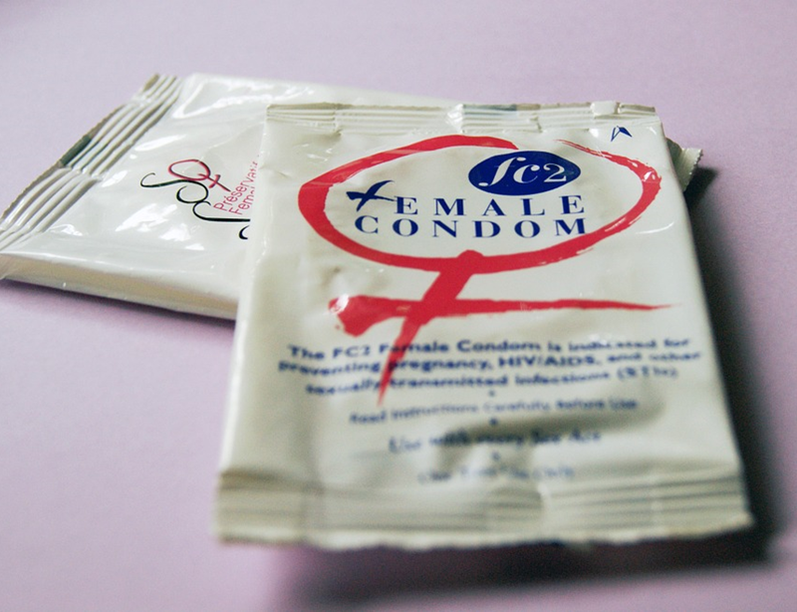

Humbowo hwakapamhidzirwa pamusoro pemakondomu:
Kana akashandiswa nguva dzose uye nemazvo, makondomu elatex ndiyo nzira yakanakisa yokudzivirira zvirwere zvepabonde zvakaita se gonorrhea, chlamydia, kana trichomonas.
Notes:
Zvakare anoderedza mukana wezvirwere zvamaronda epasikarudzi, zvakaita se genital herpes, syphilis ne chancroid, apo nzvimbo ine hutachiwana kana nzvimbo ingangopinda hutachiwana yakadzivirirwa. Angangoderedza njodzi yehutachiwana hwesikarudzi hwe `human papilloma virus` (HPV) uye zvirwere zvinechekuita ne HPV (zvakaita se mhopo dzepasikarudzi negomarara repamuromo wechibereko.

Slide 16
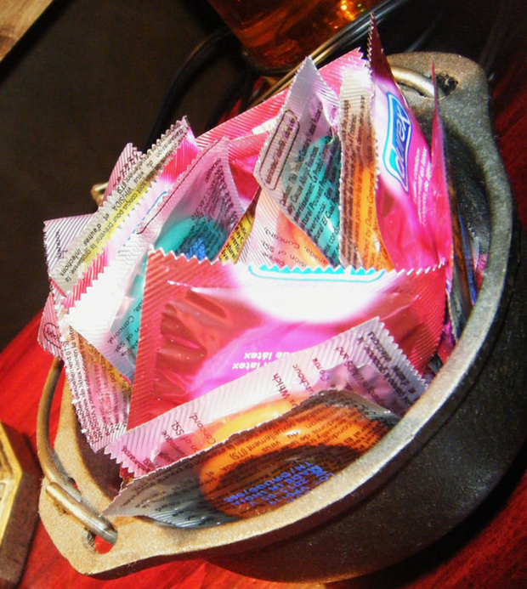
Nzira dzekushandisa makondomu nemazvo uye nguva dzose:
Shandisa kondomu idzva pakusangana pose pabonde (nemumukanwa, nemunzira yesikarudzi yemudzimai uye nekumashure kunobuda netsvina).

Slide 17
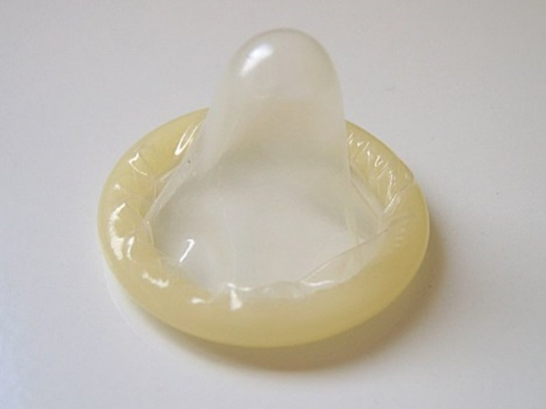

Nzira dzekushandisa makondomu nemazvo uye nguva dzose:
Nyatsobata kondomu kudzivirira kuridimbura nenzara, mazino kana zvimwe zvigadzirwa zvinobaya.
Pfeka kondomu mushure mekunge nhengo yesikarudzi yechirume yamira uye usati yabatana nechero nhengo yesikarudzi, nemukanwa kana nekumashure kunobuda netsvina kwoumwe wako.

Slide 18
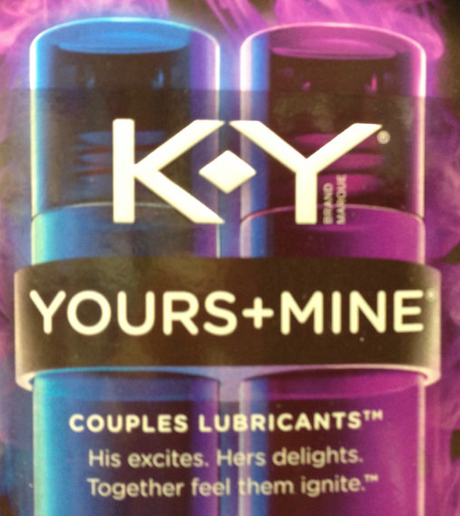
Nzira dzekushandisa makondomu nemazvo uye nguva dzose:
Iva nechokwadi kuti panekutsvedzerera (lubrication) kwakakwana pakusangana pabonde nemukati mesikarudzi yemudzimai uye nekumashure kunobuda netsvina, asi shandisa zvinotsvedzerera (lubricants)
zvinemvura nemakondomu elatex (zvakaita se K-Y jelly).
Zvinotsvedzerera (lubricants) zvine mafuta zvakaita seVaseline kana mafuta ekuzora (muviri) zvinozokuvadza makondomu.

Slide 19
Nzira dzekushandisa makondomu nemazvo uye nguva dzose:
Kudzivirira kuti kondomu risabve, bata kondomu zvakasimba wakaritsimbidzira kuzasi kwenhengo yesikarudzi yechirume pakubvisa, uye bvisa nhengo yesikarudzi yechirume ichakamira.

Slide 20

Kana muine mibvunzo kana kuti muchida humbowo hwakapamhidzirwa, tapota vhakachirai kiriniki yetsvakurudzo.

